Slide 1
Azure Databricks in Advanced Analytics Scenarios
Paweł Potasiński

Slide 2
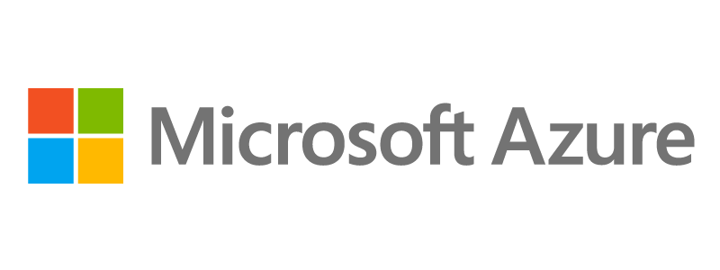
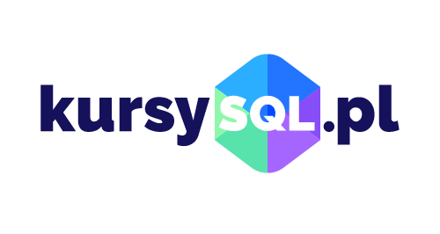

Sponsors

Slide 3

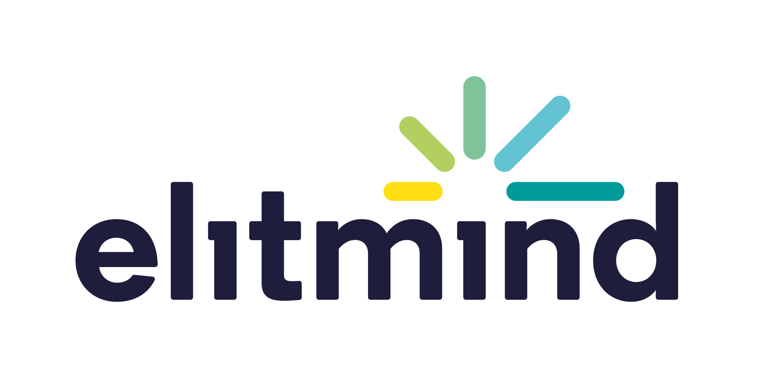


Speaker
CTO @ Elitmind
Founder of PLSSUG (now DC.pl)
Microsoft MVP
Strong SQL background
Fan of automation and smart work

Slide 4

Agenda
Introduction to Databricks
Data Access and Integration
Data Analytics
Data Engineering (ETL)
Other Workloads
Sample Scenarios
Summary & Resources

Slide 5
Introduction to Databricks

Slide 6
Modern Data Platform
Management
Master Data
Metadata
Data Quality
Security
Orchestration
Business Apps
Data Sources
Landing Area
Data Warehouse
Logical Data Model
Data Virtualization
Reporting
Online Data
Self-service BI
Sandbox
Historical Data
Advanced Analytics
Data Lake
Real-time Processing of the Streaming Data

Slide 7
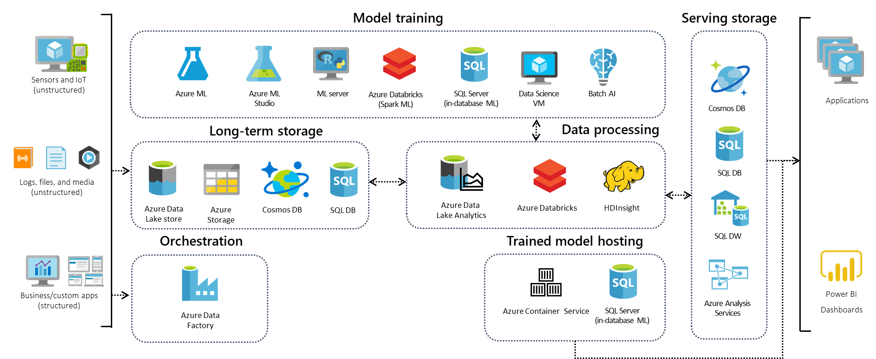
Data Analytics in Azure

Slide 8
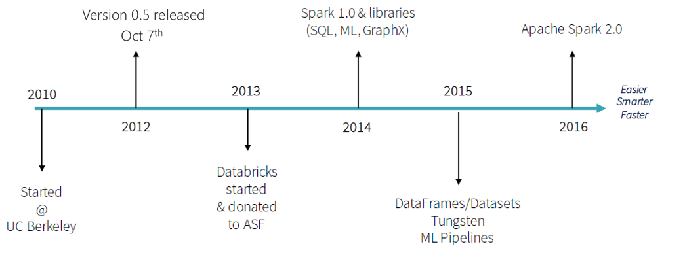
History of Spark

Slide 9
Apache Spark
Spark Unifies:
Batch Processing
Interactive SQL
Real-time processing
Machine Learning
Deep Learning
Graph Processing
Spark SQL
Interactive Queries
Spark MLlib
Machine Learning
Spark Streaming
Stream processing
GraphX
Graph Computation
Spark Core Engine
Yarn
Mesos
Standalone Scheduler

Slide 10
Apache Spark - Benefits
Performance
Developer Productivity
Ecosystem
Using in-memory computing
Even 100x faster than Hadoop
Can be used for batch and real-time data processing
Easy-to-use APIs for processing large datasets
Includes 100+ operators for transforming
Unified Engine
Integrated framework includes higher-level libraries for interactive SQL queries, Stream Analytics, ML and more
A single application can combine all types of processing
Spark has built-in support for many data sources, rich ecosystem of ISV applications, and a large dev community
Available on multiple public clouds (AWS, Google and Azure) and multiple on-premises distributors

Slide 11
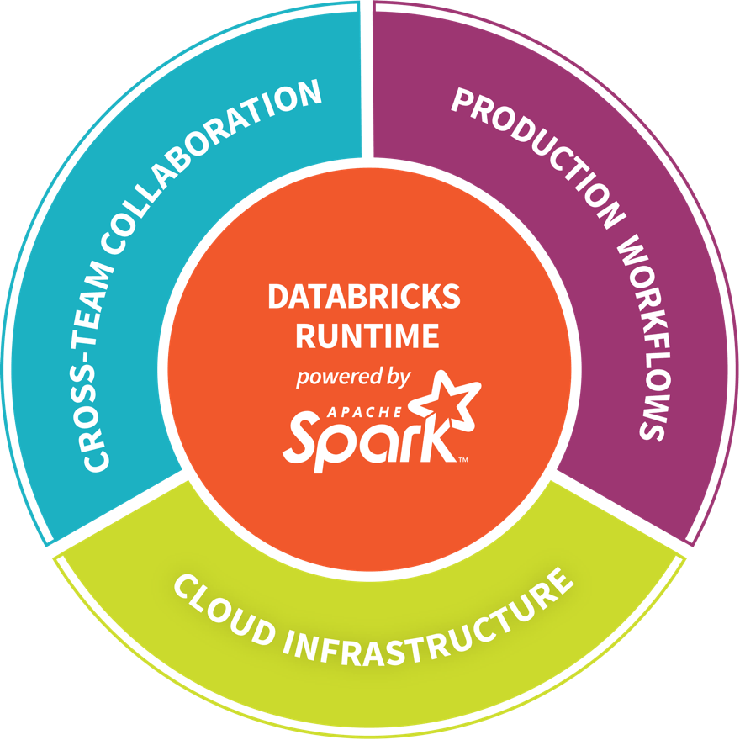
Databricks – Company Overview
Founded in late 2013
Creators of Apache Spark, original team from UC Berkeley AMPLab
Largest code contributor code to Apache Spark
Level 2/3 support partnership with Big Data vendors
Certifications - such as Databricks Certified Application, Databricks Certified Distribution, and Databricks Certified Developer
Main Product: The Unified Analytics Platform
In Oct 2017, introduced Databricks Delta

Slide 12
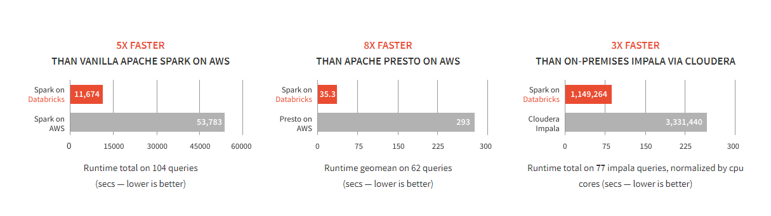
Databricks Spark Performance
SOURCE: Benchmarking Big Data SQL Platforms in the Cloud

Slide 13

Why Spark Is Fast? (1 of 2)
In-memory cluster computing: Spark provides primitives for in-memory cluster computing. A Spark job can load and cache data into memory and query it repeatedly (iteratively) much quicker than disk-based systems.
Scala Integration: Spark integrates into the Scala programming language, letting you manipulate distributed datasets like local collections. No need to structure everything as map and reduce operations
Faster Data-sharing: Data-sharing between operations is faster as data is in-memory:
In (traditional) Hadoop data is shared through HDFS which is expensive. HDFS maintains three replicas.
Spark stores data in-memory without any replication.
Data Sharing between Steps of a Job
Read from HDFS
Write to HDFS
Read from HDFS
Write to HDFS
In Traditional MapReduce
Step 1
Step 2
Read from HDFS
In Spark
Step 1
Step 2

Slide 14
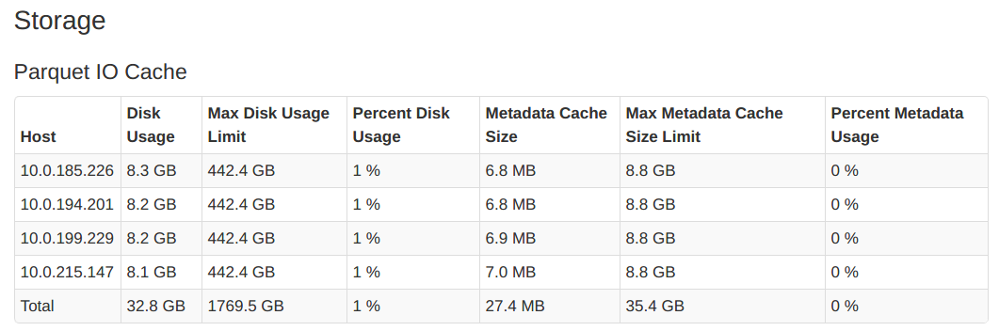
Why Spark Is Fast? (2 of 2)
A copy of the remote file is created in the node’s local storage
Local data is stored in a fast intermediate format
Currently Parquet file format is supported
Remote data is cached automatically
Supports DBFS, HDFS, Azure Blob Storage and Azure Data Lake store
DBIO Cache lets you
Enable or disable caching at anytime
Cache only a select subset of the data
DBIO Cache has to be configured during cluster creation. The ‘max disk space per node reserved for cached data’ must be specified during cluster creation
You can Monitor the state of the DBIO cache in the Portal

Slide 15





Azure – Big Data Offerings
CONTROL
EASE OF USE
Azure Data Lake
Analytics
Data Engineering in a
Job-as-a-service model
Azure Databricks
Frictionless & Optimized Spark clusters
Azure HDInsight
Workload optimized, managed clusters
Reduced Administration
Azure Marketplace
HDP | CDH | MapR
BIG DATA ANALYTICS
Any Hadoop technology, any distribution
IaaS Clusters
Managed Clusters
Big Data as-a-service
Azure Data Lake Analytics
Azure Data Lake Store
BIG DATA STORAGE
Azure Storage

Slide 16
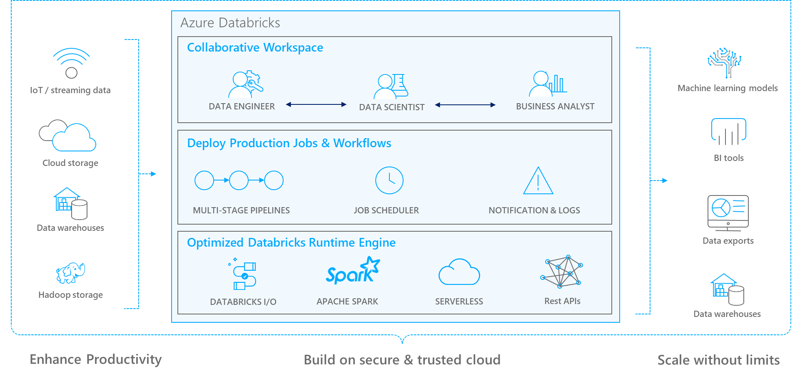
Azure Databricks
Notes:
Databricks, founded by the team that created Apache Spark – unified analytics platform that accelerates innovation by unifying data science, engineering & business.
75% of the code committed to Apache Spark comes from Databricks
Unified Runtime
Create clusters in seconds, dynamically scale them up and down.
They’ve made enhancements to Spark engine to make it 10x faster than open source Spark
Serverless- Auto-configured multi-user cluster, Reliable sharing with fault isolation
Unified Collaboration
Overall – a simple & collaborative environment that enables your entire team to use Spark & interact with your data simultaneously
DE – Improve ETL performance, zero management clusters. Execute production code from within notebooks
DS - For data scientists, easy data exploration in notebooks
Business SME – interactive dashboards empower teams to create dynamic reports
Enterprise Security
Encryption
Fine grained Role-based access control (files, clusters, code, application, dashboard)
Compliance
Rest APIs
DE – DBIO, SPARK, API’s , JOBS
DS – Spark and Serverless, Interactive Data Science
Data Products - Everything
Creators of Spark
Training People
Number of Customers
Ingest
Workflow
Schedule / Run / Monitor
Execute
Troubleshoot
Debug
Production Jobs
---------
Ingest, ETL, Scheduling, Monitoring

Slide 17

Azure Databricks
Azure Databricks is a first party service on Azure.
Unlike with other clouds, it is not an Azure Marketplace or a 3rd party hosted service.
Azure Databricks is integrated seamlessly with Azure services:
Azure Portal: Service an be launched directly from Azure Portal
Azure Storage Services: Directly access data in Azure Blob Storage and Azure Data Lake Store
Azure Active Directory: For user authentication, eliminating the need to maintain two separate sets of users in Databricks and Azure.
Azure SQL DW and Azure Cosmos DB: Enables you to combine structured and unstructured data for analytics
Apache Kafka for HDInsight: Enables you to use Kafka as a streaming data source or sink
Azure Billing: You get a single bill from Azure
Power BI: For rich data visualization
Eliminates need to create a separate account with Databricks.
Microsoft Azure

Slide 18
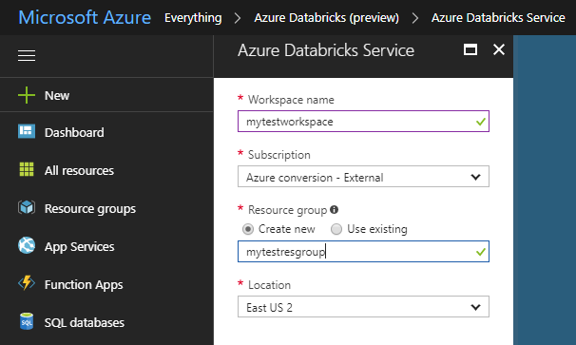
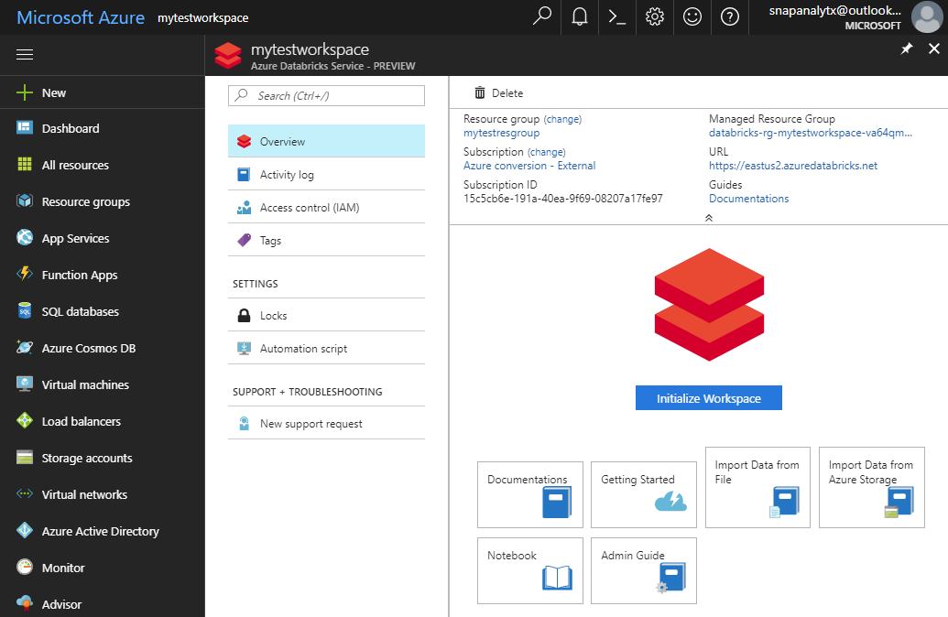
Azure Databricks Workspace
Azure Databricks is provisioned directly from the Azure Portal like any other Azure service
In contrast, with other clouds, it has to be provisioned through the Databricks portal
With Azure Databricks, the Azure Portal offers a unified portal to provision and administer Azure Databricks as well as other Azure services
Any Azure user with the appropriate subscription and authorization can provision Azure Databricks service
There is no need for a separate Databricks account
Provisioning the Azure Databricks Service
After provisioning is complete

Slide 19




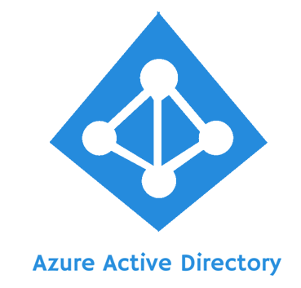
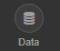
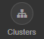
Azure Databricks Integration with AAD
There is no need to define users - and their access control—separately in Databricks
AAD users can be used directly in Azure Databricks for all user-based access control (Clusters, Jobs, Notebooks etc.).
Databricks has delegated user authentication to AAD enabling single-sign on (SSO) and unified authentication.
Notebooks, and their outputs, are stored in the Databricks account. However, AAD-based access-control ensures that only authorized users can access them
Access
Control
Authentication
Azure Databricks

Slide 20




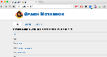
Databricks Artifacts
Clusters
Libraries
Workspaces
Azure Databricks
Jobs
Notebooks

Slide 21
Spark Cluster
Driver runs the user’s „main” function and executes the various parallel operations on the worker nodes
The results of the operations are collected by the driver
The worker nodes read and write data from/to Data Sources including HDFS
Worker node also cache transformed data in memory as RDDs (Resilient Data Sets)
Worker nodes and the Driver Node execute as VMs in public clouds (AWS, Google and Azure)
Driver Program SparkContext
Cluster Manager
Worker Node
Worker Node
Worker Node
Cache
Cache
Cache
Task
Task
Task
Data Sources (HDFS, SQL, NoSQL, …)

Slide 22
Azure Databricks Cluster Architecture
Spark History Server
Webapp
Log Daemon
Azure Compute
Spark Worker
Azure Compute
Azure DB for PostgreSQL
Spark Driver
Azure Compute
FileSystem
Service
Jobs
Cluster Manager
Azure Compute
Spark Worker
Log Daemon
Databricks’ Azure Account
User’s Azure Account
Resource in the Databricks’ account are not visible to users

Slide 23
Cluster Manager
Cluster
Azure Compute
Webapp
Jobs
Spark Worker
Azure Compute
Spark Driver
Cluster Manager
Azure Compute
Spark Worker
Library Manager
Container Management
Instance Manager
Cluster
Azure Compute
Spark Worker
Azure Compute
Spark Driver
Azure Compute
Spark Worker
Database
Instances, Clusters, Libraries, Hive Metastore, …

Slide 24

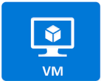
Clusters
Azure Databricks clusters are the set of Azure Linux VMs that host the Spark Worker and Driver Nodes
Your Spark application code (i.e. Jobs) runs on the provisioned clusters
Azure Databricks clusters are launched in your subscription, but are managed through the Azure Databricks portal
Azure Databricks provides a comprehensive set of graphical wizards to manage the complete lifecycle of clusters—from creation to termination

Slide 25
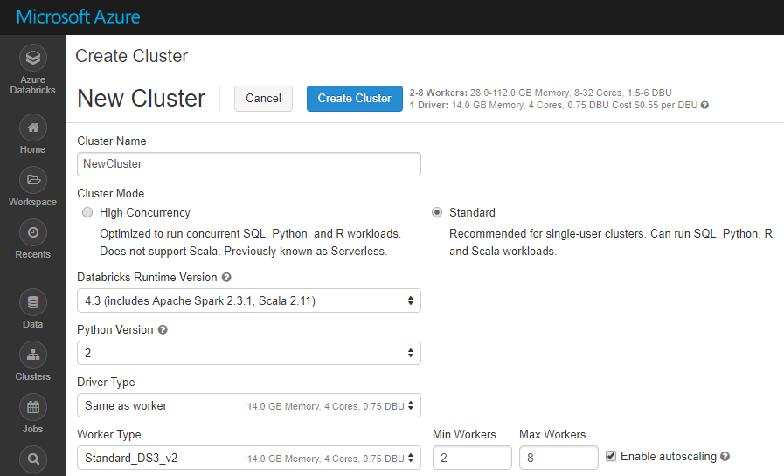
Cluster Creation
You can create two types of clusters – Standard and High Concurrency
While creating a cluster you can specify:
Number of nodes
The Azure VM instance types for the Driver and Workers
Autoscaling and Auto Termination policy
Spark Configuration details
Graphical wizard in the Azure Databricks portal to create a Standard Cluster

Slide 26
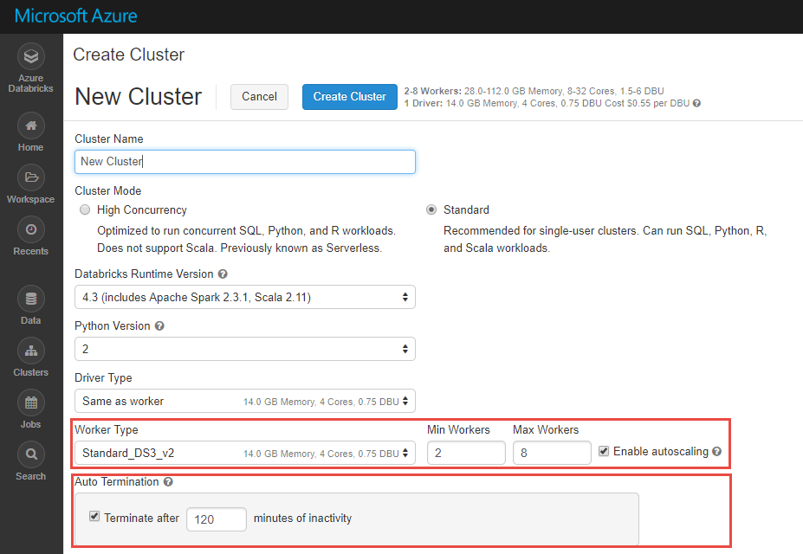
Clusters – Autoscaling & Auto Termination
Autoscaling: specify the min and max number of clusters, and Azure Databricks automatically scales up or down based on load
Auto Termination: after the specified minutes of inactivity the cluster is automatically terminated
Benefits:
You don’t guess the number of nodes
No need to manually tweak the nodes
No resource wasting
No more unnecessary wating for job completion

Slide 27
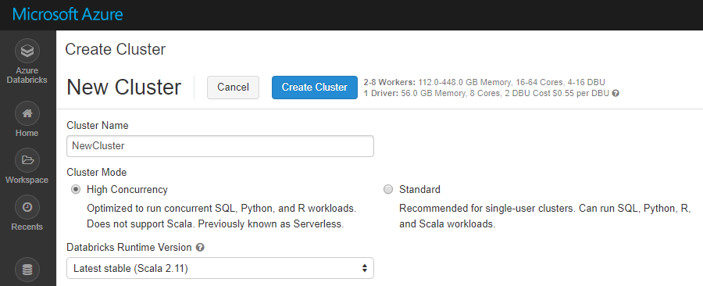
High Concurrency Clusters
Optimized for concurrent SQL, Python, and R workloads (limited!)
Limitation: Does NOT work for Scala.
Benefits of High Concurrency Clusters
Auto-Configuration | Databricks chooses the best configuration for Spark to get the best performance Users don’t need to worry about providing any of the Databricks runtime version or Spark configuration. Databricks also chooses the best cluster parameters to save cost on infrastructure
Elasticity | Automatically scales the compute and local storage, independently, based on usage
Fine grained Sharing | Offers maximum resource utilization and minimum query latencies Preemption: Databricks proactively preempts Spark tasks from over-committed users to ensure all users get their fair share of cluster time and their jobs complete in a timely manner even when contending with dozens of other users. Uses the “Task Preemption for High Concurrency” feature of Spark in Databricks. Fault isolation: Databricks sandboxes the environments belonging to different notebooks from one another.

Slide 28
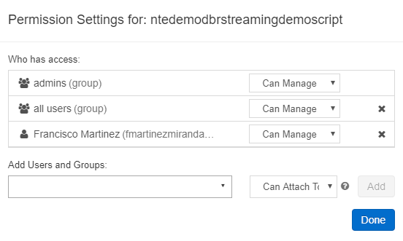
Cluster Access Control
Two types of permissions for Cluster Access Control:
Individual Cluster Permissions
Cluster Creation Permissions
Individual permissions can be configured on the Clusters Page by clicking on Permissions
Four permission levels:
No Permissions, Can Attach To, Can Restart, Can Manage

Slide 29
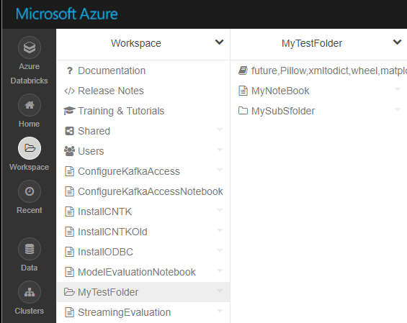
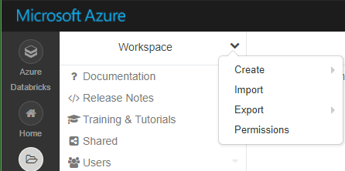
Workspaces
Workspaces - sort of like Directories - are a convenient way to organize user’s Notebooks, Libraries and Dashboards
Everything in a workspace is organized into hierarchical folders.
Folders can hold Libraries, Notebooks, Dashboard or more (sub) folders
Icons indicate the type of the object contained in a folder
Every user has one directory that is private and unshared
By default, the workspace and all its contents are available to users
Fine grained access control can be defined on workspaces to enable secure collaboration with colleagues

Slide 30
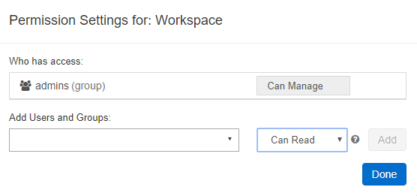
Workspace Operations
You can search the entire Databricks workspace
In the Azure Databricks Portal, via the Workspaces drop down menu, you can:
Create Folders, Notebooks and Libraries
Import Notebooks into the Workspace
Export the Workspace to a database archive
Set Permissions
Four levels of permissions:
Can Manage, Can Read, Can Edit, Can Run

Slide 31
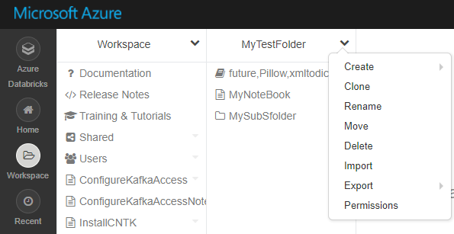
Folder Operations and Access Control
In the Azure Databricks Portal, via the Folder drop down menu, you can:
Create Folders, Notebooks and Libraries within the folder
Clone the folder to create a deep copy of the folder
Rename or delete the folder
Move the folder to another location
Export a folder to save it and its contents as a Databricks archive
Import a saved Databricks archive into the selected folder
Set Permissions for the folder
Five levels of permissions:
No Permissions, Can Manage, Can Read, Can Edit, Can Run

Slide 32
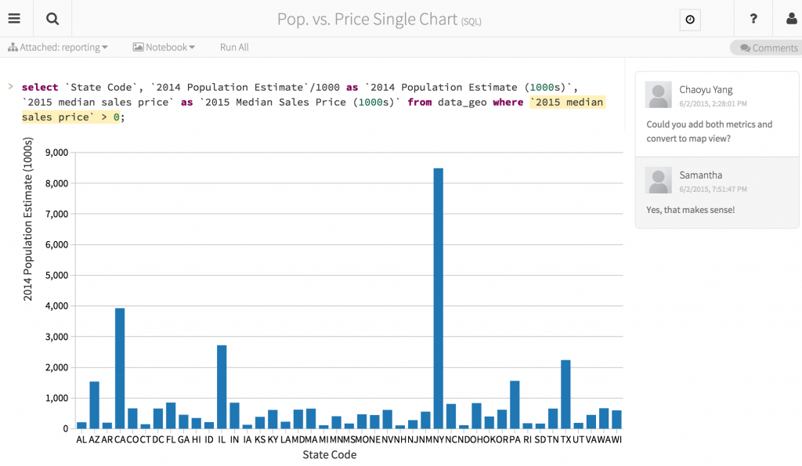
Notebooks
Notebooks are not only for authoring Spark applications but can be run/executed directly on clusters
Shift+Enter / Ctrl+Enter
Click the at the top right of the cell in a notebook
Submit via Job
Notebooks support fine grained permissions - so they can be securely shared with colleagues for collaboration (see following slide for details on permissions and abilities)
Notebooks are well-suited for prototyping, rapid development, exploration, discovery and iterative development

Slide 33
Mixing Languages in Notebooks
Normally a notebook is associated with a specific language
However, with Azure Databricks notebooks, you can mix multiple languages in the same notebook
This is done using the language „magic commands”
%python Allows you to execute python code in a notebook (even if that notebook is not python)
%sql Allows you to execute sql code in a notebook (even if that notebook is not sql).
%r Allows you to execute r code in a notebook (even if that notebook is not r).
%scala Allows you to execute scala code in a notebook (even if that notebook is not scala).
%sh Allows you to execute shell code in your notebook.
%fs Allows you to use Databricks Utilities - dbutils filesystem commands.
%md To include rendered markdown

Slide 34
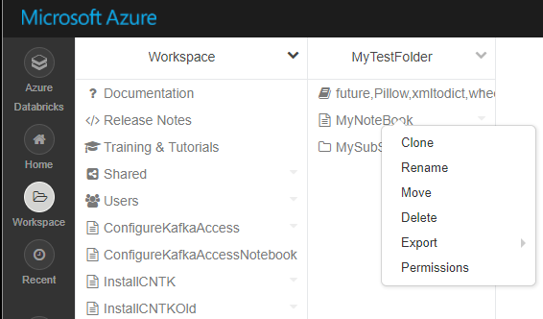
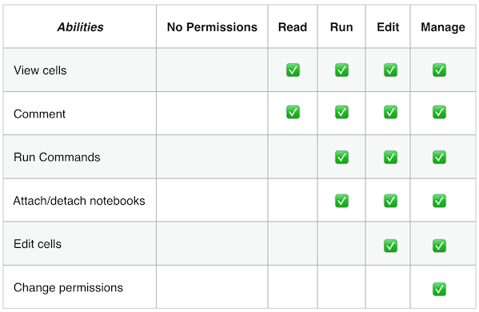
Notebook Operations and Access Control
You can create a new notebook from the Workspace or the Folder drop down menu
From a notebook’s drop down menu you can:
Clone the notebook
Rename or delete the notebook
Move the notebook to another location
Export a notebook to save it and its contents as a Databricks archive or IPython notebook or HTML or source code file
Set Permissions for the notebook
As with Workspaces you can set 5 levels of permissions: No Permissions, Can Manage, Can Read, Can Edit, Can Run
You can also set permissions from notebook UI itself by selecting the menu option.
Abilities associated with each permission level

Slide 35
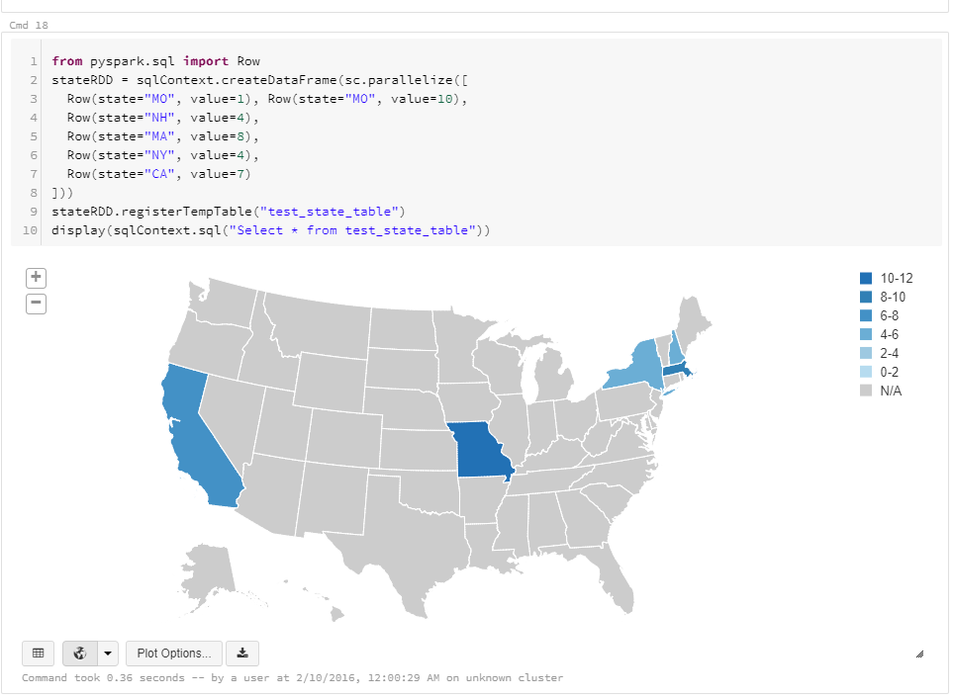
Visualization
All notebooks, regardless of their language, support Databricks visualizations
When you run the notebook the visualizations are rendered inside the notebook in-place
The visualizations are written in HTML
You can save the HTML of the entire notebook by exporting to HTML
If you use Matplotlib, the plots are rendered as images so you can just right click and download the image
You can change the plot type just by picking from the selection

Slide 36
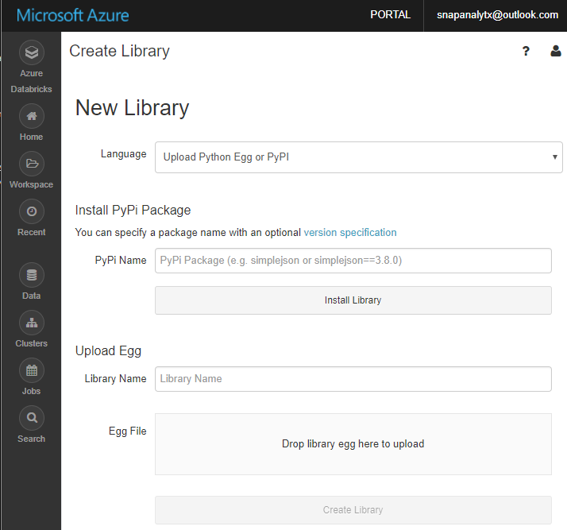
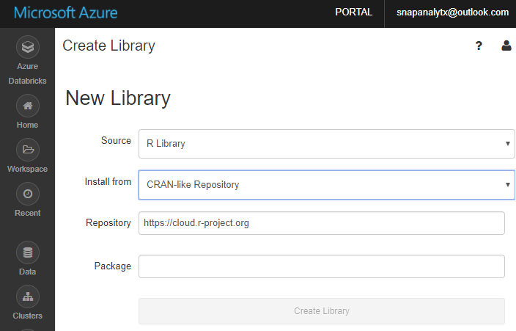
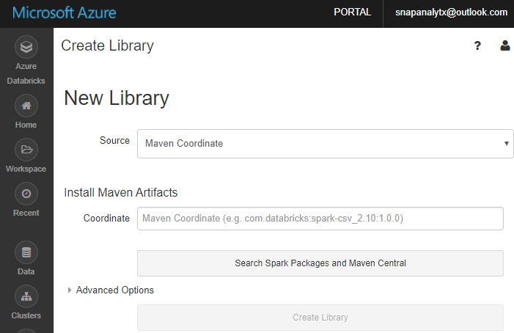
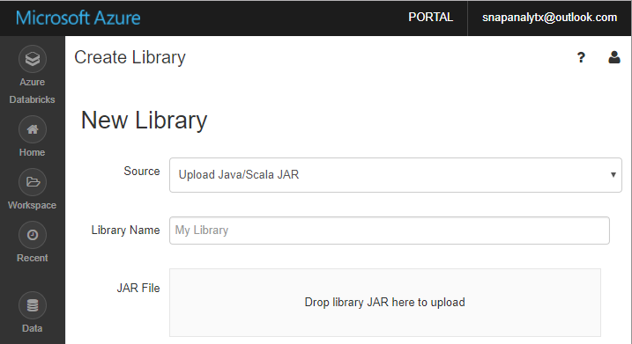
Libraries Overview
Libraries are containers to hold all your Python, R, Java/Scala libraries
Libraries resides within workspaces or folders
Libraries are created by importing the source code
After importing libraries are immutable - can be deleted or overwritten only
You can customize installation of libraries via Init Scripts by writing custom UNIX scripts
Libraries can also be managed via the Library API

Slide 37
Databricks File System (DBFS)
Azure Storage buckets can be mounted in DBFS so that users can directly access them without specifying the storage keys
DBFS mounts are created using dbutils.fs.mount()
Azure Storage data can be cached locally on the SSD of the worker nodes
Available in both Python and Scala and accessible via a DBFS CLI
Data persist in Azure Blob Storage – is not lost even after cluster termination
Comes pre-installed on Spark clusters in Databricks
Python
Scala
CLI
dbutils
DBFS
db.fs.mount()
db.fs.mount()
Azure Blob Storage

Slide 38

Jobs
Jobs are the mechanism to submit Spark application code for execution on the Databricks clusters
Spark application code is submitted as a Job for execution on Azure Databricks clusters
Jobs execute either Notebooks or Jars
Azure Databricks provide a comprehensive set of graphical tools to create, manage and monitor Jobs

Slide 39
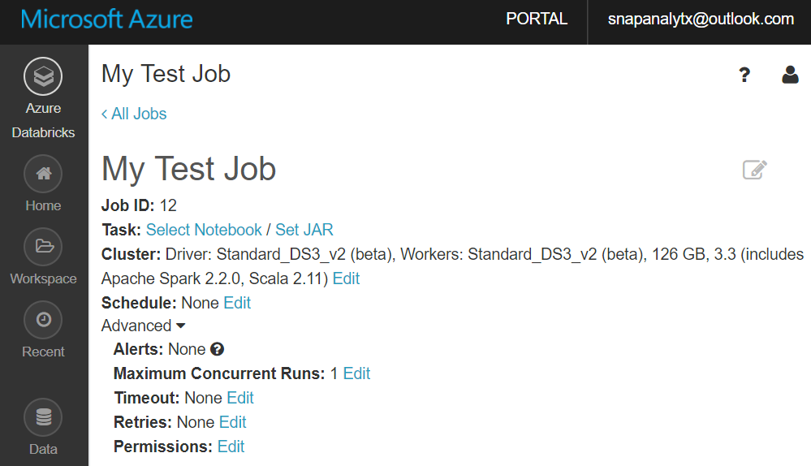
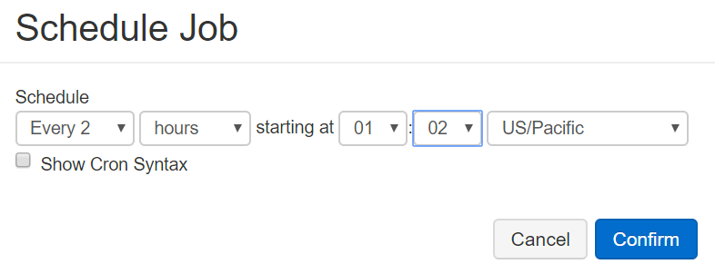
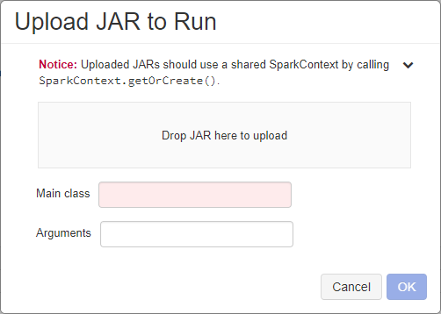
Creating and Running Jobs (1 of 2)
When you create a new Job you have to specify:
The Notebook or Jar to execute
Cluster: the cluster on which the Job execute
This could be an existing or new cluster
Schedule, i.e. how often the Job runs
Jobs can also be run one time right away

Slide 40
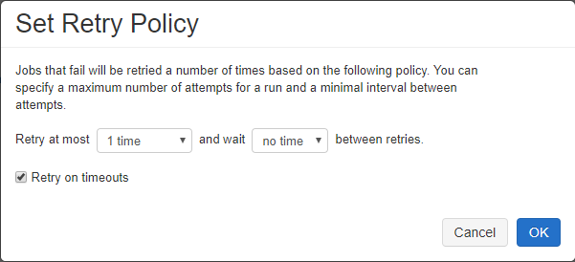
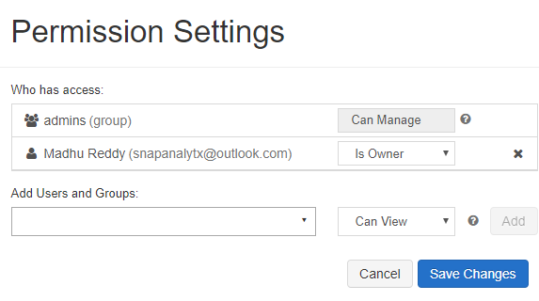
Creating and Running Jobs (2 of 2)
When you create a new job you can optionally specify advanced options:
Maximum number of concurrent runs of the Job
Timeout: Jobs still running beyond the specified duration are automatically killed
Retry Policy: Specifies if—and when—failed jobs will be retried
Permissions: Who can do what with jobs. This allows for Job definition and management to be securely shared with others (see next slide)

Slide 41
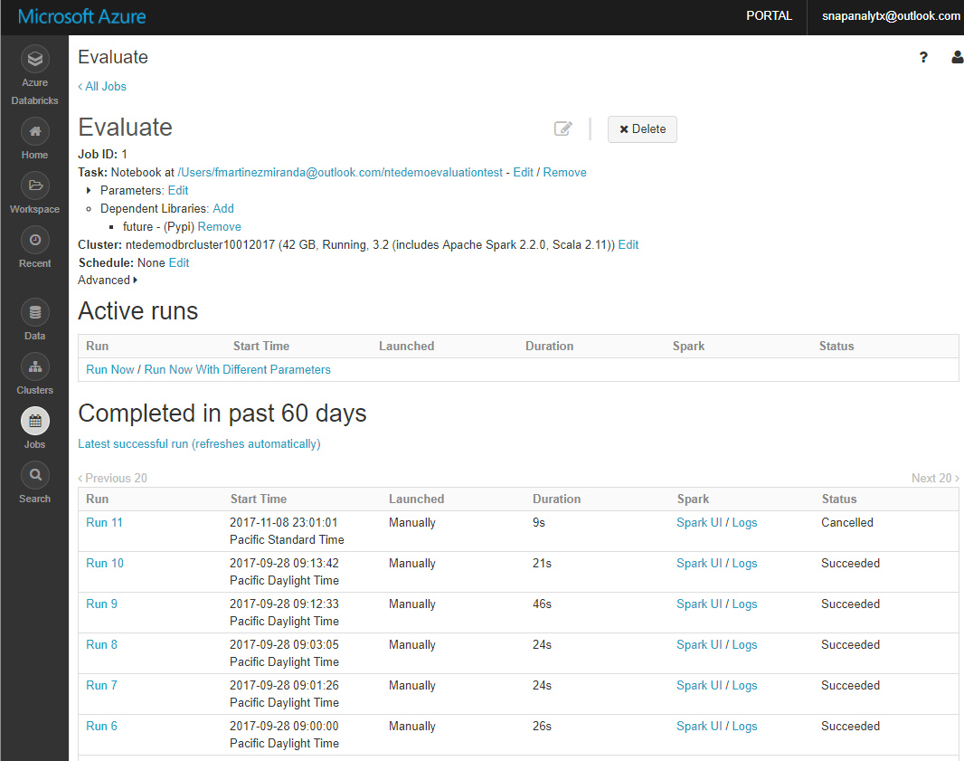
Jobs History
In the Azure Databricks Jobs Portal you can view:
The list of currently running (Active) Jobs
History of old Job runs (for up to 60 days)
The output of a particular Job run (including standard error, standard output, Spark UI logs)

Slide 42
Data Access and Integration

Slide 43
Blob Storage Integration
Data can be read from Azure Blob Storage using the Hadoop FileSystem interface. Data can be read from public storage accounts without any additional settings. To read data from a private storage account, you need to set an account key or a Shared Access Signature (SAS) in your notebook or use Azure Key Vault.
Setting up an account key
spark.conf.set ( "fs.azure.account.key.{Your Storage Account Name}.blob.core.windows.net", "{Your Storage Account Access Key}")
Setting up a SAS for a given container:
spark.conf.set( "fs.azure.sas.{Your Container Name}.{Your Storage Account Name}.blob.core.windows.net", "{Your SAS For The Given Container}")
Once an account key or a SAS is setup, you can use standard Spark and Databricks APIs to read from the storage account:
val df = spark.read.parquet("wasbs://{Your Container Name}@m{Your Storage Account name}.blob.core.windows.net/{Your Directory Name}")
dbutils.fs.ls("wasbs://{Your ntainer Name}@{Your Storage Account Name}.blob.core.windows.net/{Your Directory Name}")

Slide 44
Azure Data Lake Gen2 Integration
Four ways to access ADLS Gen2
Pass your AAD credentials, also known as credential passthrough
Mount an ADLS Gen2 filesystem to DBFS using a service principal and OAuth 2.0
Use a service principal directly
Use the ADLS Gen2 storage account access key directly
https://docs.azuredatabricks.net/spark/latest/data-sources/azure/adls-passthrough.html

Slide 45
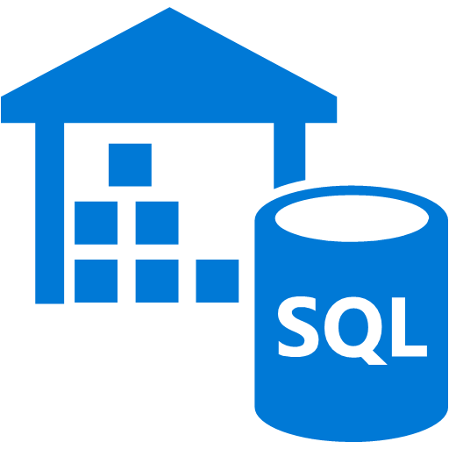
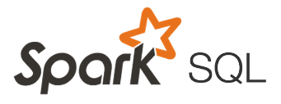

Azure SQL DW Integration
You can bring in data from Azure SQL DW to perform advanced analytics that require both structured and unstructured data
Currently you can access data in Azure SQL DW via the JDBC driver
If Azure SQL DW is authenticated via AAD then Azure Databricks user can seamlessly access Azure SQL DW
Azure Databricks
Azure SQL DW

Slide 46
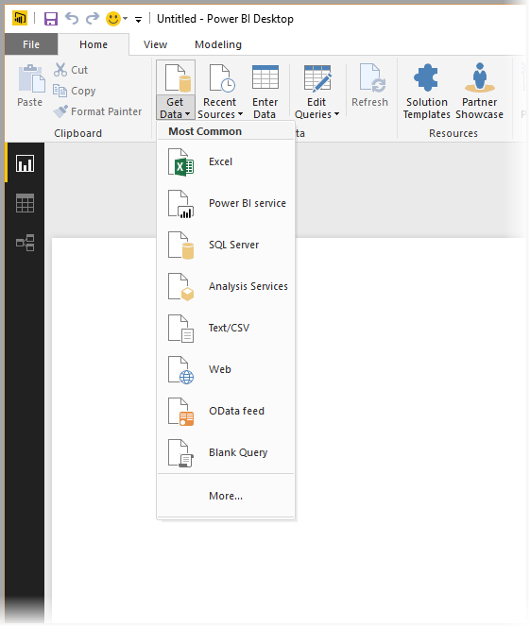
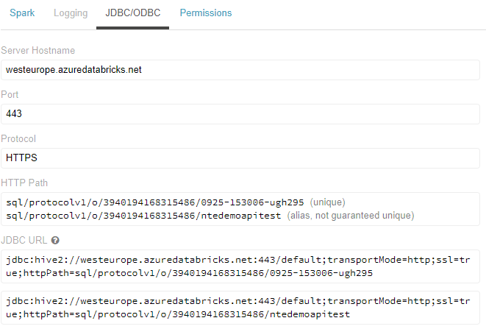
Power BI Integration
Power BI Desktop can connect to Azure Databricks clusters to query data using JDBC/ODBC server that runs on the driver node
This server listens on port 10000 and it is not accessible outside the subnet where the cluster is running
Azure Databricks uses a public HTTPS gateway
The JDBC/ODBC connection information can be obtained from the Cluster UI directly as shown in the figure
When establishing the connection, you can use a Personal Access Token to authenticate to the cluster gateway. Only users who have attach permissions can access the cluster via the JDBC/ ODBC endpoint
In Power BI desktop you can setup the connection by choosing the ODBC data source in the “Get Data” option

Slide 47
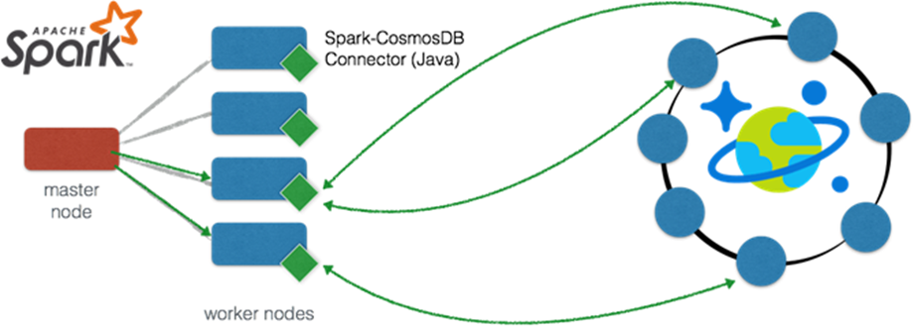
Azure Cosmos DB Integration
With Spark connector for Azure Cosmos DB, Apache Spark can now interact with all Azure Cosmos DB data models: Documents, Tables, and Graphs
Efficiently exploits the native Azure Cosmos DB managed indexes and enables updateable columns when performing analytics.
Utilizes push-down predicate filtering against fast-changing globally-distributed data
Some use-cases for Azure Cosmos DB + Spark include:
Streaming Extract, Transformation, and Loading of data (ETL)
Data enrichment
Trigger event detection
Complex session analysis and personalization
Visual data exploration and interactive analysis
Notebook experience for data exploration, information sharing, and collaboration

Slide 48
Data Analytics

Slide 49
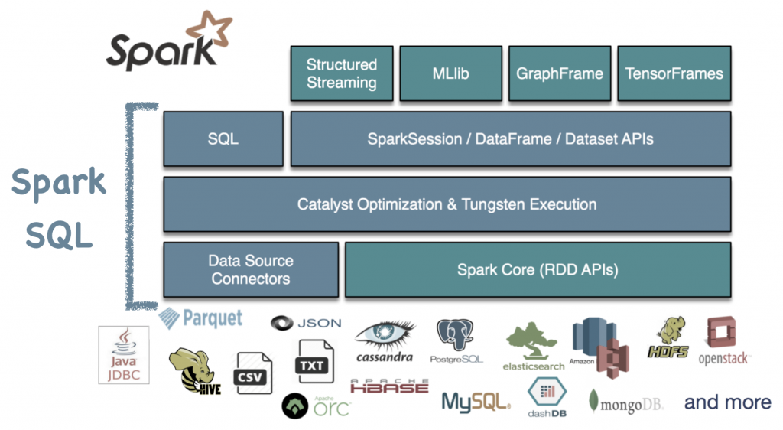
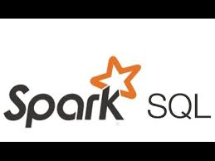
Spark SQL Overview
Spark SQL is a distributed SQL query engine for processing structured data
Can query data stored in wide variety of data sources - external databases, structured data files, Hive tables and more
Data can be queried using either SQL or HiveQL
Has bindings in Python, Scala and Java
Has built-in support for structured streaming
Built using the Catalyst optimizer and Tungsten execution

Slide 50
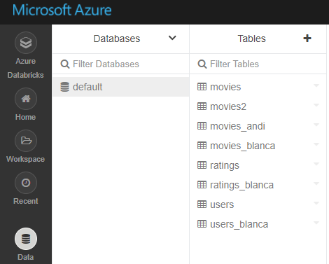
Databases and Tables Overview
Databases are a collection of related tables
Tables are defined using the GUI in the console or programmatically using APIs or Notebooks
Databricks uses the Hive metastore to manage tables, and supports all file formats and Hive data sources
Like Apache Spark DataFrames, any Spark operation can be applied to Tables (including caching, filtering)
Partitioned Tables and Partition Pruning: Spark SQL is able to dynamically generate partitions at the file storage level to provide partition columns for tables
When the table is scanned, Spark pushes down the filter predicates involving the partitionBy keys for partition pruning.

Slide 51
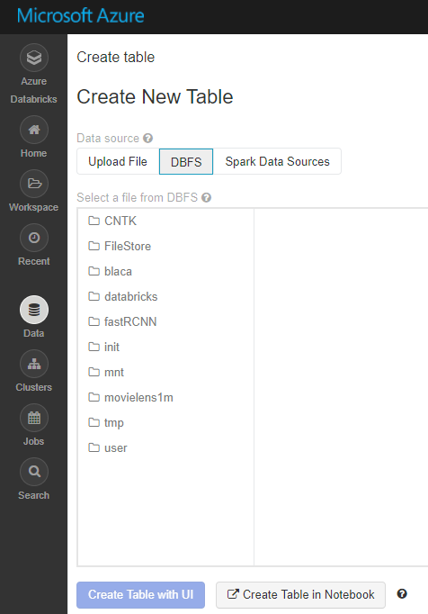
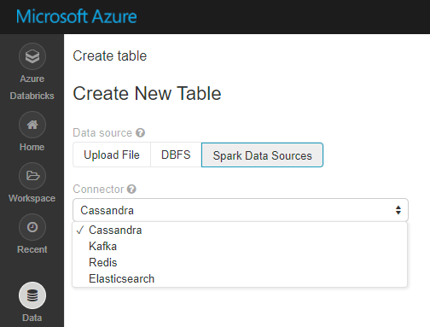
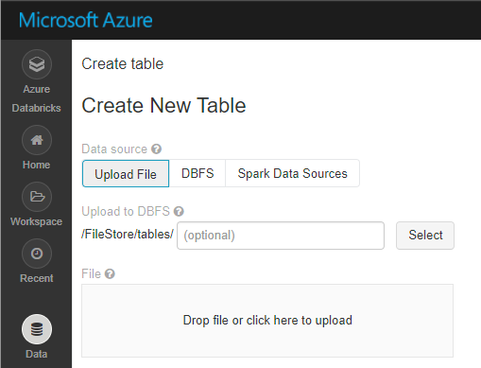
Ways to Create Table
From Spark Data Sources
From local files (in CSV, JSON or Avro formats)
From data in DBFS
Note: You can also create tables programmatically (CREATE TABLE tablename …)
Notes:
When creating tables from DBFS
Databricks will not read data from a table created from storage until a user accesses it.
If you change the data in the storage directory, the table will reflect the new data

Slide 52
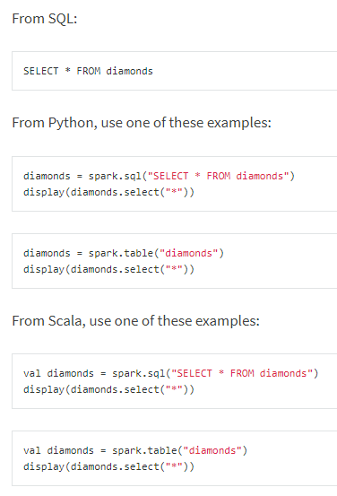

Table Operations
Azure Databricks tables support the following operations
Listing database and tables
Viewing table details including its schema and sample data
Reading from tables
Updating tables: Table schema is immutable. However, a user can update table data by changing the underlying files.
Deleting tables: A user can delete tables either through the UI or programmatically

Slide 53
Local and Global Tables
Azure Databricks Tables
Global Tables
Local Tables
Databricks registers global tables to the Hive metastore and makes them available across all clusters
Only global tables are visible in the Tables pane
Databricks does not register local tables in the Hive metastore and are only available within one cluster
Also known as temporary tables

Slide 54
Delta Lake
Open source storage layer that brings reliability to data lakes
Major benefits:
ACID transactions on Spark – no inconsistent data for readers
Scalable metadata handling - handle all the metadata for petabyte-scale tables with billions of files
Streaming and batch unification- a table in Delta Lake is both a batch table as well as a streaming source and sink
Schema enforcement - automatically handles schema variations to prevent insertion of bad records during ingestion
Time travel - data versioning enables rollbacks, full historical audit trails, and reproducible machine learning experiments

Slide 55
Data Engineering (ETL)

Slide 56
Typical Transformations
Handle missing values
Normalize
Deduplicate
Convert data types
Format
Change schema
Unpivot
Join
Add columns (calculations)
Filter
Aggregate

Slide 57

Integration with Azure Data Factory
Data Factory for data orchestration
Databricks notebooks as a part of ETL process
Scheduling (triggering)

Slide 58
Other Workloads

Slide 59


Spark Structured Streaming
Unifies streaming, interactive and batch queries—a single API for both static bounded data and streaming unbounded data
Runs on Spark SQL. Uses the Spark SQL Dataset/DataFrame API used for batch processing of static data
Runs incrementally and continuously and updates the results as data streams in
Supports app development in Scala, Java, Python and R
Supports streaming aggregations, event-time windows, windowed grouped aggregation, stream-to-batch joins
Features streaming deduplication, multiple output modes and APIs for managing/monitoring streaming queries
Built-in sources: Kafka, File source (json, csv, text, parquet)

Slide 60



Apache Kafka for HDInsight Integration
Apache Kafka for Azure HDInsight is an enterprise grade streaming ingestion service running in Azure
Azure Databricks Structured Streaming applications can use Apache Kafka for HDInsight as a data source or sink
No additional software (gateways or connectors) are required
Setup: Apache Kafka on HDInsight does not provide access to the Kafka brokers over the public internet
Kafka clusters and Azure Databricks cluster must be located in the same Azure Virtual Network
Kafka App
Spark App
Azure Databricks

Slide 61

Spark GraphX
Unifies ETL, exploratory analysis, and iterative graph computation within a single system
Developers can:
View the same data as both graphs and collections
Transform and join graphs with RDDs
Write custom iterative graph algorithms using the Pregel API
Currently only supports using the Scala and RDD APIs
Algorithms
PageRank
Connected components
Label propagation
SVD++
Strongly connected components
Triangle count
PageRank Benchmark

Slide 62

SparkML
Offers a set of parallelized machine learning algorithms
Supports Model Selection (hyperparameter tuning) using Cross Validation and Train-Validation Split
Supports Java, Scala or Python apps using DataFrame-based API (as of Spark 2.0).
Benefits include:
An uniform API across ML algorithms and across multiple languages
Facilitates ML pipelines (enables combining multiple algorithms into a single pipeline).
Optimizations through Tungsten and Catalyst
Spark MLlib comes pre-installed on Azure Databricks
3rd party libraries supported include: H20 Sparkling Water, SciKit-learn and XGBoost

Slide 63
SparkML Algorithms
Classification and Regression | Linear Models (SVMs, logistic regression, linear regression) Naïve Bayes Decision Trees Ensembles of trees (Random Forest, Gradient-Boosted Trees) Isotonic regression
Clustering | k-means and streaming k-means Gaussian mixture Power iteration clustering (PIC) Latent Dirichlet allocation (LDA)
Collaborative Filtering | Alternating least squares (ALS)
Dimensionality Reduction | SVD PCA
Frequent Pattern Mining | FP-growth Association rules
Basic Statistics | Summary statistics Correlations Stratified sampling Hypothesis testing Random data generation
Spark ML Algorithms

Slide 64

MMLSpark
Microsoft Machine Learning Library for Apache Spark (MMLSpark) lets you easily create scalable machine learning models for large datasets.
It includes integration of SparkML pipelines with the Microsoft Cognitive Toolkit and OpenCV, enabling you to:
Ingress and pre-process image data
Featurize images and text using pre-trained deep learning models
Train and score classification and regression models using implicit featurization

Slide 65


Deep Learning
Supports Deep Learning Libraries/frameworks including:
Microsoft Cognitive Toolkit (CNTK)
TensorFlowOnSpark
BigDL
Offers Spark Deep Learning Pipelines, a suite of tools for working with and processing images using deep learning using transfer learning. It includes high-level APIs for common aspects of deep learning so they can be done efficiently in a few lines of code:
Image loading
Applying pre-trained models as transformers in a Spark ML pipeline
Transfer learning
Distributed hyperparameter tuning
Deploying models in DataFrames and SQL
Distributed Hyperparameter Tuning
Transfer Learning

Slide 66

SparkR
Provides a distributed DataFrame implementation that supports operations like selection, filtering, aggregation etc (similar to R data frames, dplyr)
Supports distributed machine learning using Spark Mllib
R programs can connect to a Spark cluster from RStudio, R shell, Rscript or other R IDEs.
Local
Workers
Spark
Executor
Exec
Spark
Context
R-JVM bridge
Java Spark Context
Spark
Executor
Exec

Slide 67
Sample Scenarios

Slide 68

Scenario 1: FMCG – Analytical Sandbox
Benefit: 2-5 days shorter time required for ad-hoc reporting

Slide 69

Scenario 2: FMCG – Customer Data Cleansing
Benefit: 360 degree view on customer without manual work in Excel (2 days/month)

Slide 70

Scenario 3: Retail – Fraud Detection in Loyalty Program
Benefit: +3% growth of yearly revenue

Slide 71

Scenario 4: Retail – Operational Report Subscriptions
Benefit: no need of SQL Server Enterprise licenses ☺

Slide 72
Summary & Resources

Slide 73
Summary
Azure Databricks is Spark
It provides integration with other Azure services
Storage as the most important part of this integration
Notebooks are a great interface to work with data
Use your favorite language
Notebook can act as a part of ETL processes
Use integration with ADF or Databricks Jobs
People can collaborate, version code, operationalize notebooks

Slide 74

Resources
Documentation:
https://docs.databricks.com/
https://docs.azuredatabricks.net/
Resources:
https://databricks.com/resources
Pricing:
https://azure.microsoft.com/en-us/pricing/details/databricks/
Microsoft Learn:
https://docs.microsoft.com/en-us/learn/browse/?products=azure-databricks
https://www.youtube.com/results?search_query=elitmindacademy

Slide 75




Thank You!
For discussions NOT ONLY about Databricks: pawel.potasinski@elitmind.com
http://blog.sqlgeek.pl / https://github.com/pawelpo
https://www.facebook.com/pawel.potasinski
https://www.linkedin.com/in/pawelpotasinski/
https://twitter.com/PawelPotasinski

